Slide 1
OOPs (Object Oriented Programming System)

Slide 2
OOPS Concepts
Class
Object
Encapsulation
Inheritance
Polymorphism
Abstraction

Slide 3
Encapsulation
Binding (or wrapping) code and data together into a single unit is known as encapsulation.
For example: capsule, it is wrapped with different medicines.
A java class is the example of encapsulation. Java bean is the fully encapsulated class because all the data members are private here.

Slide 4

Encapsulation
Capsule
WAP for encapsulated Account class

Slide 5
Advantage of Encapsulation
It is a way to achieve data hiding in Java because other class will not be able to access the data through the private data members.
------------------------------------------------------
Suppose you want to set the value of id which should be greater than 100 only, you can write the logic inside the setter method. You can write the logic not to store the negative numbers in the setter methods.

Slide 6
Inheritance
Acquiring or getting the properties of one class into another class is known as inheritance.
A class that is derived from another class is called a subclass (also a derived class, extended class, or child class). The class from which the subclass is derived is called a superclass (also a base class or a parent class ).
The Object class, defined in the java.lang package, defines and implements behavior common to all classes including the ones that you write. In the Java platform, many classes derive directly from Object, other classes derive from some of those classes, and so on, forming a hierarchy of classes.

Slide 7
Inheritance represents the IS-A relationship which is also known as a parent-child relationship.
Advantage: Code Reusability.

Slide 8
Types of inheritance:
1) Single inheritance
2) Multiple inheritance
3) Hierarchical inheritance
4) Multilevel inheritance
5) Hybrid inheritance

Slide 9
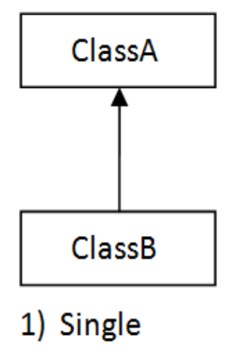
1) Single inheritance:
In this type there is only one super class and one sub class.

Slide 10
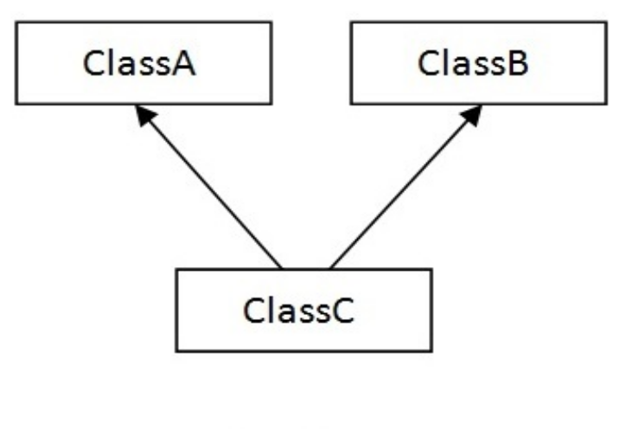
2) Multiple inheritance:
In this type a class is derived from several super classes i.e, there is only one subclass but several classes.(java does not support multiple inheritance)

Slide 11
Q) Why multiple inheritance is not supported in java?
Consider a scenario where A, B, and C are three classes. The C class inherits A and B classes. If A and B classes have the same method and you call it from child class object, there will be ambiguity to call the method of A or B class.

Slide 12
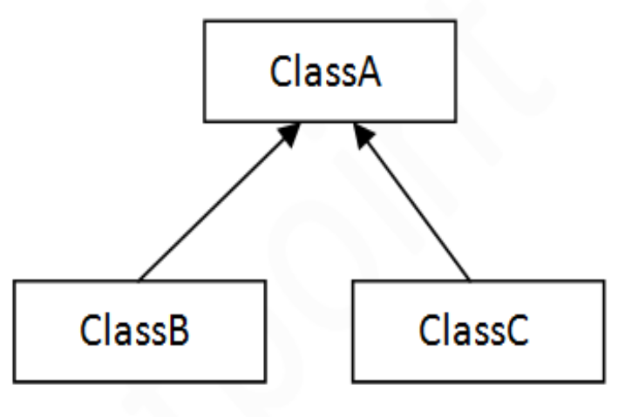
3) Hierarchical inheritance :
In this type there is only one super class but many subclasses. These subclasses are derived from only one super class.

Slide 13
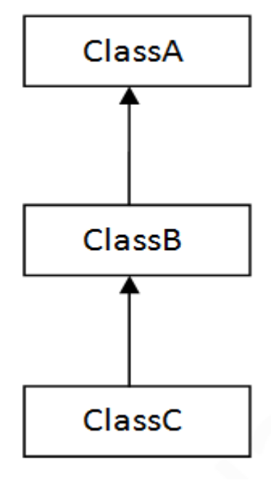
4) Multilevel inheritance :
In this type a class is derived from another sub class.

Slide 14
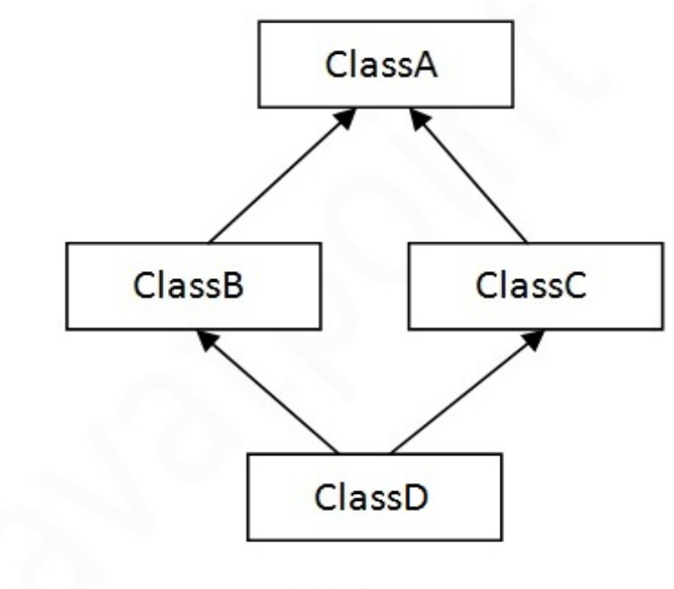
5) Hybrid inheritance :
It is a combination of multiple and hierarchical inheritance.

Slide 15
Aggregation
If a class have an entity reference, it is known as Aggregation. Aggregation represents HAS-A relationship.
Advantage: Code Reusability.
Example: Employee HAS-A Address

Slide 16
When use Aggregation?
Code reuse is also best achieved by aggregation when there is no is-a relationship.

Slide 17
Polymorphism
Polymorphism is a greek word. Poly means many, morphism means forms, which has many forms.
+ operator is used for addition and concatenation so it has polymorphic behavior.
Flask can keep any liquid item at hot or cool so it has polymorphic behavior.
In computer science the term polymorphism means “a
method the same as another in spelling but with different behavior.” The computer differentiates between (or
among) methods depending on either the method signature (after compile) or the object reference (at run time).

Slide 18
Real life example of polymorphism: A person at the same time can have different characteristic. Like a man at the same time is a father, a husband, an employee. So the same person posses different behavior in different situations. This is called polymorphism.

Slide 19
Polymorphism is divided into two types those are
1) compile-time polymorphism
2) run-time polymorphism
1) compile-time polymorphism :
It is also called as early binding or static binding because the computer knows after the compile to the byte code which of the methods it will execute.
Example: method overloading
2) run-time polymorphism :
It is also called as late binding or dynamic binding because the computer does not know at compile time which of the methods are to be executed. It will not know that until “run time.”
Example: method overriding

Slide 20
Method Overloading:
  Using same method name, the return type may be same or different, the number of parameters different, if number of parameters are same they should be appear in different order, if we uses that method more than once that method is said to be overloaded.
  Advantage: Method overloading increases the readability of the program.
  Example:

Slide 21
Method overriding:
Using same method name, return type, same number of parameters, return type of parameters & parameters should appear in same order, if we uses that method in super class (super class method is called method overridden) & sub class (sub class method is called method overriding) then that method is said to be overridden method.
Example:

Slide 22
Usage of Java Method Overriding
Method overriding is used to provide the specific implementation of a method which is already provided by its superclass.
Method overriding is used for runtime polymorphism
Example: Bank, SBI, ICICI, HDFC

